Slide 1
Open Sources for Future Internet : Part1
March 17, 2015
CS Hong

Slide 2
What is Open Software
Open Source Software (OSS) generally refers to software for which the source code is available and which the licensing scheme permits the user to modify it and redistribute it in modified or unmodified form.
GNU copyleft
Nobody should be restricted by the software they use. There are four freedoms that every user should have:
the freedom to use the software for any purpose,
the freedom to change the software to suit your needs,
the freedom to share the software with your friends and neighbors, and
the freedom to share the changes you make.
When a program offers users all of these freedoms, we call it free software

Slide 3
GNU
Goal: to bring a wholly free software operating system into existence, a Unix-like computer operating system developed by the GNU Project
is a recursive acronym for "GNU's Not Unix!", chosen because GNU's design is Unix-like, but differs from Unix by being free software and containing no Unix code
Development of GNU was initiated by Richard Stallman in 1983
GNU Manifesto: free to study the source code of the software they use, free to share the software with other people, free to modify the behavior of the software, and free to publish their modified versions of the software : GNU General Public License(GPL)

Slide 4
Linux Overview
Tux
Official Mascot of Linux Kernel

Slide 5
Brief History of GNU/Linux
1985 Free Software Foundation (FSF) founded by Richard Stallman along with other programmers it creates the tools needed to make a UNIX compatible OS
1985 Professor Andy Tannenbaum creates a UNIX like operating system based on System V Unix for the IBM PC & PC/AT computers. It is called Minix.
1989 Richard Stallman releases GPL and GNU software but lacks a free kernel.
1991 Building on the concepts in Minix, Linus Torvalds (Finnish college student) develops Linux along with help from other users on the web.

Slide 6
What Linux is
Strictly speaking Linux refers to the kernel
GNU/Linux more accurately describes the Operating System. Linux Kernel combined with GNU utilities and libraries
Distribution – GNU/Linux bundled with other applications. Examples Red Hat Linux, Debian, Ubuntu, Suse, Knoppix, etc.
Distributions can be compiled and maintained by an individual or corporation. Can be small (single floppy disk) or several CD/DVDs.
www.distrowatch.com for more information

Slide 7
Linux Distributions
Red Hat (Enterprise) Linux is probably the largest commercial Linux vendor. Focus on stability and long term support. Red Hat sponsors a community version (Fedora) which undergoes a more rapid development cycle.
KNOPPIX – The first Live CD version. The OS can be booted from, and run completely off the CD. KNOPPIX is based on Debian Linux. Many vendors now offer Live versions. No installation necessary.
Ubuntu based on Debian Linux. Ubuntu claims to be most popular desktop version. Many applications and excellent “update mechanism” contribute to its success. Revenue is created by selling technical support.
Puppy – This distribution is small enough to be loaded entirely in RAM. This frees up the CD/DVD drive for other uses. Configuration can be saved to a file between reboots.
Recovery Is Possible (RIP) is good for data recovery of corrupted media or backup. Tools such as Ddrescue allows copying media sector by sector. Can repair NTFS or FAT partitions.

Slide 8
Applications
Samba is a free implementation of the Server Message Block (SMB) protocol used by Microsoft Windows network file system. Allows sharing files, print services, and can even act as a domain controller.
Apache is the most popular HTTP server software on the internet.
Rsync allows synchronizing directories/files locally or across a network. Suited for low bandwidth as only changes get propagated across network.

Slide 9
Other Open Source Software
The GIMP - Adobe Photoshop clone
Open Office - Office suite
Mozilla Firefox - Web browser
Mozilla - Thunderbird E-mail Client
VLC - Media player
Audacity - Digital audio editor
MySQL – Database
Ghostscript - Postscript interpreter

Slide 10
Possible Uses
Various tools permit user to recover data, repair/modify partitions, backup and clone various types of media. “DD type” tools allow copying a storage device by blocks/sectors. This allows duplicating a device without “knowing the filesystem”.
Linux can natively communicate with DECNET protocol. This allows a Linux PC to act as an End Node in a VMS cluster. Other DECNET tools allow additional inter-connectivity between the two OSs.
With Samba and Ghostscript a Linux PC can be a Windows PDF print server. Giving individuals the ability to create PDF files without buying Adobe Acrobat or installing additional applications on each computer.

Slide 11
Who uses it
NSA created Security Enhanced Linux (SELinux) to develop better allow the control of dynamic security policies. The architecture they created has been mainstreamed into Linux and ported to other operating systems including Solaris, and Free BSD.
IBM, HP, and Sun contribute heavily to Linux and OSS
Even Microsoft’s position on OSS has softened and they are now contributing code to various projects.

Slide 12
Miscellaneous Information
The Linux Documentation Project provide HOWTOs and Guides to accomplish many Linux specific tasks.
Linux runs on a wide range of processors from embedded devices such as cell phones to supercomputers employing Linux clusters. One estimate from Forbes.com estimates that 60% of the worlds top 500 computers runs Linux.
The availability of the OS source code allows it to be customized and tailored to users’ needs.

Slide 13
Web sites for more info and software
Sourceforge.net
Freshmeat.net
Distrowatch.com
www.linux.org
Tldp.org The Linux Documentation Project

Slide 14
GNU Free Software
http://directory.fsf.org/wiki/GNU
Networking Software :
GNU MAC Changer: a utility to manipulate a MAC address
GNU SASL: Simple Authentication and Security Layer(SASL) network authentication library
Gnuradio: Software to create digital radio signals
GNUtls: A library implementing TLS 1.0 and SSL 3.0 protocols
Gvpe: Secure vpn network among multiple nodes over an untrusted network
Lsh: Free implementation of the SSH protocol
Osip: Library supporting the Session Initiation Protocol

Slide 15
GNU Free Software (2)
Radius: Remote authentication and accounting system
SIP Witch: a pure SIP-based office telephone call server that offers generic business telephone system features
Shishi: Free implementation of the Kerberos 5 network security system
WebSocket4J: a WebSocket protocol implementation in Java
Zebra: Implementation of routing protocols
Hardware : H-Node Hardware Database
- A listing of hardware that supports free software :http://h-node.org/

Slide 16
Open Routing Platform : Routing Chronology
1984 BSD 4.2 ships with routed (RIPv1)
1986 Fuzz Ball PDP-11 NSFNet Routers
1988 Age of dedicated routing machines
Cisco, Proteon, Wellfleet, ACC
1992 Gated Consortium Formed
1996 GNU Zebra
2002 Quagga, XORP

Slide 17
Routing Platform : Zebra
by Kunihiro Ishiguro
Zebra makes your computer a router!
And a Gateway router too!!
Benefits
Test new configurations
New routing policies
New protocols
Don’t disturb the production network
Use cheap PCs instead of expensive routers

Slide 18
Zebra Architecture
Zebra routing manager
BGPd
RIPd
OSPFd
UNIX Kernel

Slide 19
Zebra features
Features
Can handle unlimited # of Interfaces
One process per one protocol
Route Server & Route Reflector integrated
Multithread based technology
Policy control and filtering

Slide 20
Routing Platform : Quagga
Modular Design
One process per protocol
bgpd, ospfd, ripd
One main controlling process
zebra
Extensible

Slide 21
Quagga Routing Architecture
Modular Design
One process per protocol
bgpd, ospfd, ripd
One main controlling process
zebra
Extensible

Slide 22
Quagga Architecture Diagram
ospfd
ripd
bgpd
zebra
Unix Kernel Routing Table

Slide 23
Quagga Routing Protocols
RIPv1, RIPv2, RIPng
OSPFv2, OSPFv3
BGP-4, BGP+
BGP route server and reflector
IPv6
Supported RFCs
1058 RIPv1, 2453 RIPv2, 2080 RIPng
2328 OSPFv2, 2740 OSPF for Ipv6
1771 BGPv4, 1965, 1997, 2545 BGPv6, 2796 BGP Route Reflection, 2858 Multiprotocol extensions, 2842 Capabilities Advertisement

Slide 24
Quagga Supported Platforms
GNU Linux
Debian, RedHat, SuSE, Slackware
Kernels 2.2.x - 2.4.x
FreeBSD
versions 4.x and 5.x
OpenBSD
version 3.x
NetBSD
version 1.4
Solaris
2.6 and version 7

Slide 25
Hardware Requirements
CPU Intel 2.0 – 3.0 Ghz
Memory 512MB
Disks 18GB
RAID-1 (optional)
SCSI or IDE
Ethernet Interfaces
2 x 10/100 Intel, 2 x 10/100/100 Broadcom
Redundancy
hot spare serves as backup to N production units

Slide 26
Open Routing Platform : XORP
eXtensible Open Router Platform
Open source router software suite, designed from the outset with extensibility in mind.
Main core unicast and multicast routing protocols.
Event-driven multi-process architecture.
BSD-style license
560,000 lines of C++

Slide 27
XORP Contributions
Staged design for BGP, RIB.
Scriptable inter-process communication mechanism.
Dynamically extensible command-line interface and router management software.
Extensible policy framework.
First fully extensible, event-driven, open-source routing protocol suite: www.xorp.org.

Slide 28
XORP Status: IGP Standards
RIP and RIPng:
RFC 2453 (RIP version 2)
RFC 2082 (RIP-2 MD5 Authentication)
RFC 2080 (RIPng for IPv6)
OSPFv2:
RFC 2328 (OSPF Version 2)
RFC 3101 (The OSPF Not-So-Stubby Area (NSSA) Option)

Slide 29
XORP Status: BGP Standards
draft-ietf-idr-bgp4-26 (A Border Gateway Protocol 4 (BGP-4))
RFC 3392 (Capabilities Advertisement with BGP-4)
draft-ietf-idr-rfc2858bis-03 (Multiprotocol Extensions for BGP-4)
RFC 2545 (Multiprotocol Extensions for IPv6 Inter-Domain Routing)
RFC 3392 (Capabilities Advertisement with BGP-4)
RFC 1997 (BGP Communities Attribute)
RFC 2796 (BGP Route Reflection - An Alternative to Full Mesh IBGP)
RFC 3065 (Autonomous System Confederations for BGP)
RFC 2439 (BGP Route Flap Damping)

Slide 30
XORP Status: Multicast Standards
PIM-SM:
draft-ietf-pim-sm-v2-new-11 (without SSM).
draft-ietf-pim-sm-bsr-03
IGMP v1 and v2:
RFC 2236
MLD v1:
RFC 2710

Slide 31
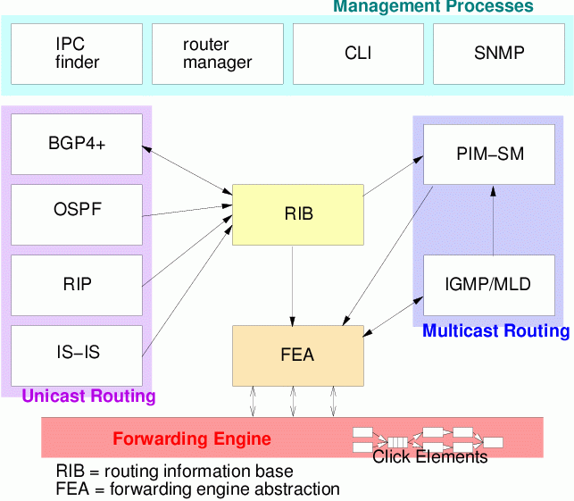
XORP Processes
Multi-process architecture, providing isolation boundaries between separate functional elements.
Flexible IPC interface between modules

Slide 32
Open Wireless Software Platform : GNUradio
Why GNU Radio?
Extensive knowledge involved
What is implemented currently?
Library
Architecture
Development environment
Development Boards

Slide 33
Why GNU Radio?
Almost free!
All the software are free (Python and C++ source code/linux environment)
In most condition, no need expensive RF test machine!
No need to purchase development and emulation tools
Only a development board needed (Universal Software Radio Peripheral)
Flexible
Software:
reconfigurable for many other modulation methods for both standardize radio or self-defined radio
it is possible to improve the quality of the received signal by utilizing, in software, certain mathematical algorithms
Hardware:
Rx and Tx are selectable
Intermediate frequency is controllable
Best choice for research use and radio amateur

Slide 34
Extensive knowledge involved
Software and environment:
Python/Numeric python library/wxPython
C++/boost C++ libraties
Linux environment and lots of support packages: FFTW/cppunit/SWIG/SDCC/
GNU Radio architecture
Communications and RF:
DSP
Digital communications
Wireless communications theory
FPGA and Assemble language may be used

Slide 35
What is implemented
Base System
Provides the runtime and various signal processing primitives
Hardware Support
Universal Software Radio Peripheral (USRP)
Audio Device Support
ALSA (Advanced Linux Sound Architecture)
OSS (Open Sound System)
Graphics Support
wxPython based GUI
SDL video library
General Signal Processing
Specialty Application Areas

Slide 36
Library
Communication related implementation
AM demodulation
Differential BPSK / QPSK
GMSK modulation / demodulation
Narrow band FM transmitter / receiver
Wide band FM transmitter & broadcast FM receiver

Slide 37
Library (cont.)
GNU radio utilities
CRC generator
Socket setup (TCP / UDP)
Compute frequency response of a digital filter
Control National IMX2306 & SDR-1000 frequency synthesizer
Some utilities
Convert unsigned mask into signed integer
Gcd, Lcm, Log2
Return input ‘x’ that is reverse order

Slide 38
Library (cont.)
GUI examples
Provide window application for different usage
FFT sink test
wxPython EditBox, Slider
Drawing
Waterfall sink test
Oscilloscope Test Application

Slide 39
Library (cont.)
pager
Create USRP source object supplying complex floats
Flex pager protocol demodulation block

Slide 40
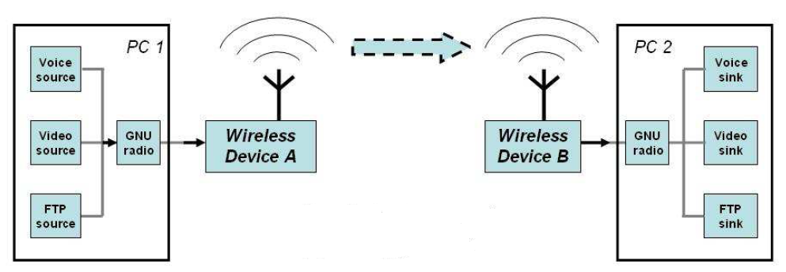
Architecture – overall
Hardware
Software

Slide 41
Architecture – Hardware
Sender
User-defined
Code
USB
FPGA
DAC
RF
Front end
PC
USRP (mother board)
Receiver
User-defined
Code
USB
FPGA
ADC
RF
Front end

Slide 42
Architecture – Software
Sender
User-defined
Code
USB
FPGA
DAC
RF
Front end
PC
GNU radio has provided some useful APIs
What we are interested in at this time is how to use the existing modules that has been provided in GNU radio project to communicate between two end systems

Slide 43
Architecture – Software
How these modules co-work?
C++
Performance-critical modules
Python
Glue to connect modules
Non performance-critical modules

Slide 44
Development Boards
Description | Price
USRP Motherboard | $700.00
BasicTX -- 2 MHz to 200 MHz Transmitter | $75.00
BasicRX -- 2 MHz to 300+ MHz Receiver | $75.00
LFTX -- DC-30 MHz Transmitter | $75.00
LFRX -- DC-30 MHz Receiver | $75.00
TVRX -- 50 MHz to 870 MHz Receiver | $100.00
DBSRX -- 800 MHz to 2.4 GHz Receiver | $150.00
RFX400 -- 400-500 MHz Transceiver | $275.00
RFX900 -- 800-1000MHz Transceiver | $275.00
RFX1200 -- 1150 MHz - 1450 MHz Transceiver | $275.00
RFX1800 -- 1.5-2.1 GHz Transceiver | $275.00
RFX2400 -- 2.3-2.9 GHz Transceiver, 20+mW output | $275.00

Slide 45
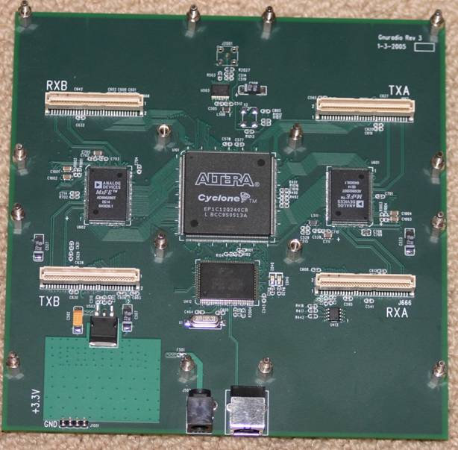
USRP Motherboard
Four 64 MS/s 12-bit analog to digital Converters
Four 128 MS/s 14-bit digital to analog Converters
Four digital downconverters with programmable decimation rates
Two digital upconverters with programmable interpolation rates
High-speed USB 2.0 interface (480 Mb/s)
Capable of processing signals up to 16 MHz wide
Modular architecture supports wide variety of RF daughterboards
Auxiliary analog and digital I/O support complex radio controls such as RSSI and AGC
Fully coherent multi-channel systems (MIMO capable)

Slide 46
Installation Guide for Ubuntu
Ubuntu already added GNU Radio packages to their repositories
System > Administration > Synaptic Package Manager
Search “gnuradio”
Select all related gnuradio libs and then apply to install
To install from console by using command line:
Check: http://gnuradio.org/redmine/projects/gnuradio/wiki/UbuntuInstall

Slide 47
Installation Guide for Fedora
1. Install all basic required package for building GNU radio
$ yum groupinstall "Engineering and Scientific" "Development Tools"
$ yum install fftw-devel cppunit-devel wxPython-devel libusb-devel guile
boost-devel alsa-lib-devel numpy
2. Download and build GNU Radio
$ svn co http://gnuradio.org/svn/gnuradio/trunk gnuradio
$ ./bootstrap # Do NOT perform this step if you are building from a
tarball. $ ./configure $ make $ make check $ sudo make install
3. Install small device C compiler for USRP
$ yum install sdcc
$ export PATH=/usr/libexec/sdcc:$PATH
4. Export python environment parameter
$ export PYTHONPATH=/usr/local/lib/python2.4/site-packages
5. Test an USRP application
./usrp_wfm_rcv.py -f 96.3
http://gnuradio.org/redmine/projects/gnuradio/wiki/FedoraInstall

Slide 48
Open Wireless Software Platform : OpenWRT Wireless Router
Embedded Linux for wireless routers
Full command-line environment
Appropriate device drivers
WWW interface for simple configuration
Why screw around with flash on my router??
Tweak the service configuration
firewall
local DNS
DHCP
Get more out of the hardware
signal strength
afterburner
VLAN switch - DMZ

Slide 49
Linksys WRT54GL
CPU/Filesystem resources
Broadcom 5352 200Mhz
RAM 16 MB
Flash 4 MB
Networking
Wireless interface (including "afterburner")
Ethernet bridge (bridges to wireless)
VLAN switch
Other Hardware:
Other Hardware:
http://wiki.openwrt.org/TableOfHardware

Slide 50
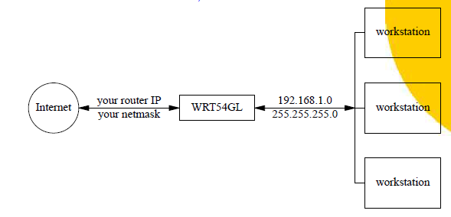
Role of the Router
Default OpenWRT setup
router does address translation for hosts
can forward service requests to servers
allocates local IP
answers DNS queries

Slide 51
Important Safety Tip
The WRT54G (not GL) is much less capable:
2 MB RAM 8 MB flash
VxWorks OS
very brickable
New from Amazon
WRT54G: $49.99
WRT54GL: $64.99
WRT54GS: $69.99
WRST54GS: $99.99 - USB!

Slide 52
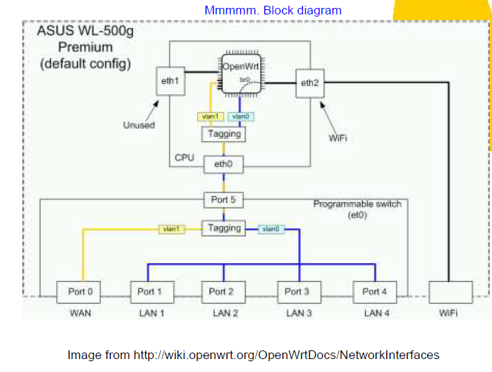
The Innards of the WRT54GL

Slide 53
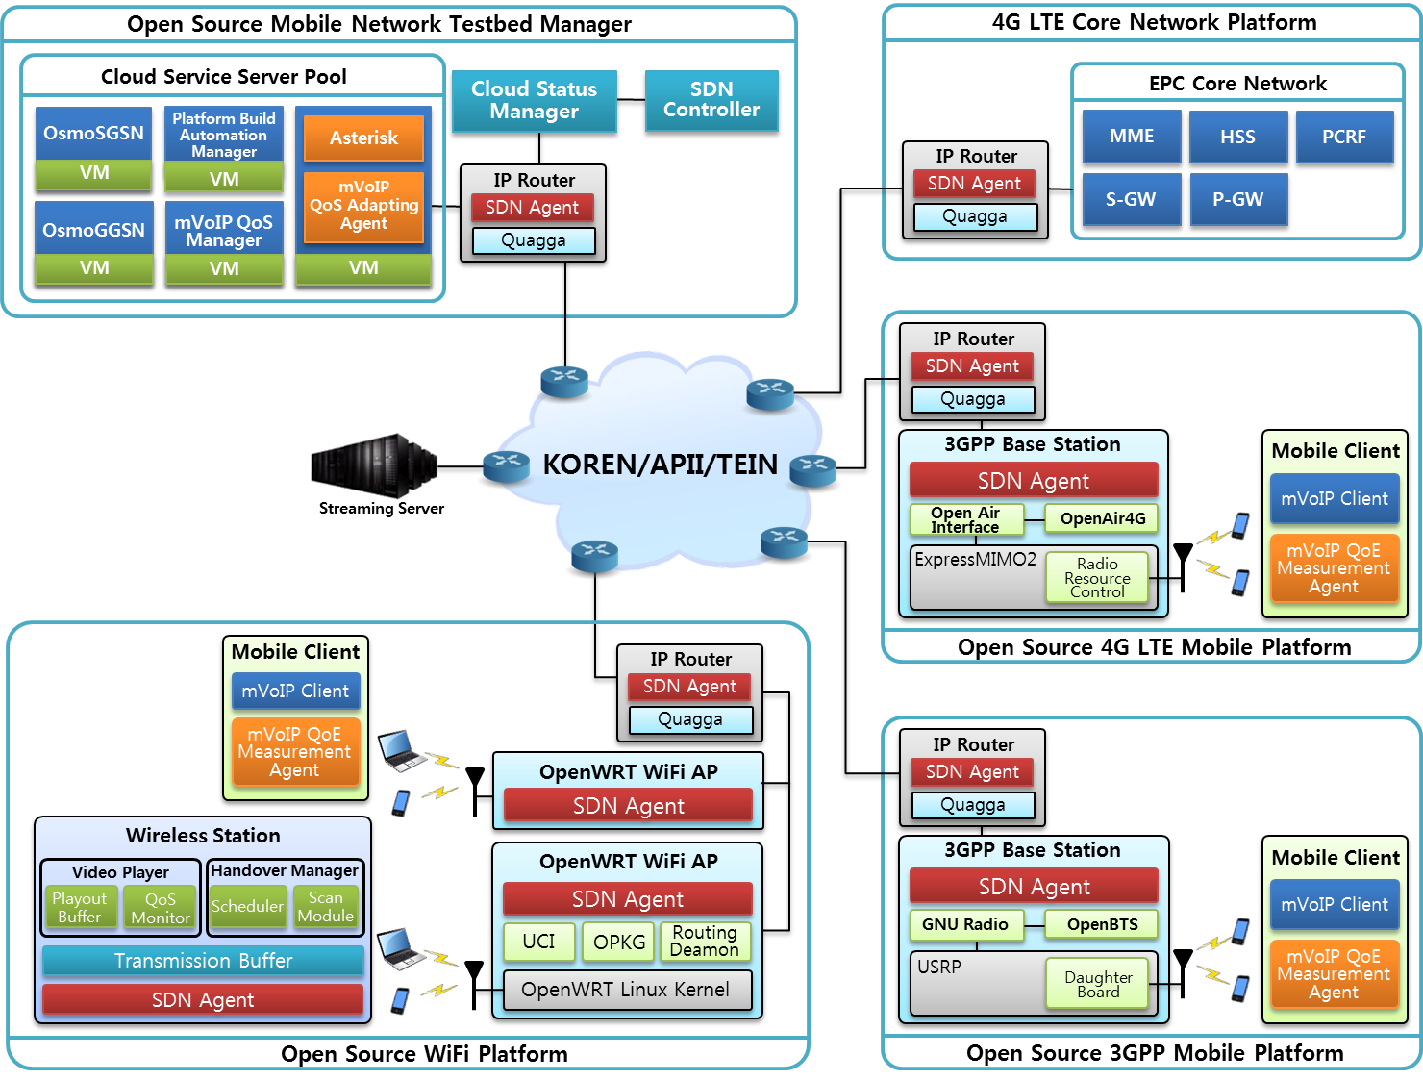
Implementation using Open Sources

Slide 54
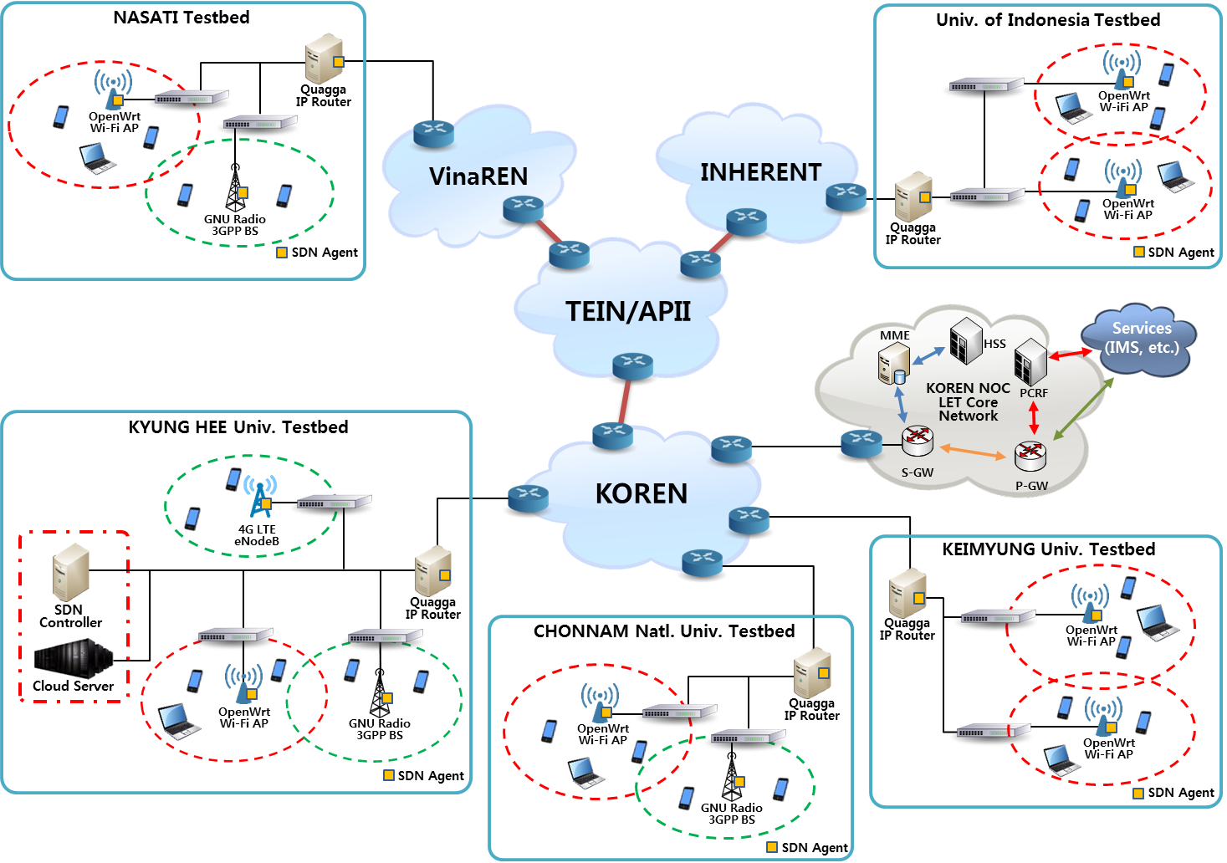
An Experiment

Slide 55
References
http://www.zebra.org
A part of PPT by Russell Sutherland, Computing and Networking Services, University of Toronto
www.xorp.org
GNU Radio - University of Florida
www.OpenWRT.org

Slide 56
Thank you !

